Slide 1
Group 10
COMPARISON OF
NEURAL NETWORK ARCHITECTURES
FOR
ART GENRE CLASSIFICATION
USING IMAGE METADATA
HOON HAN
JOONHYOUNG LEE
STEPHEN YEAP WELLER

Slide 2
TABLE OF CONTENTS
INTRODUCTION
DATASET OVERVIEW
DATA PREPROCESSING
MODEL’S ARCHITECTURE
EVALUATIONS & RESULTS
LIMITATIONS & POTENTIALIMPROVEMENTS

Slide 3
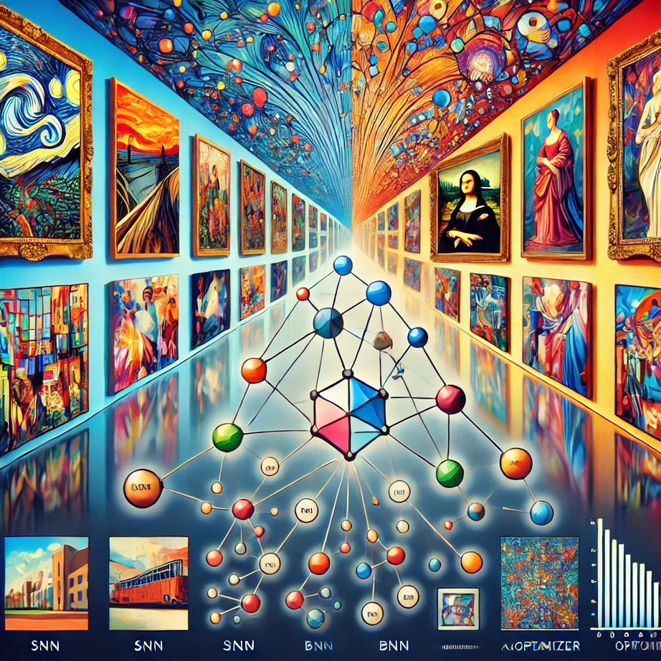
Introduction
Project Objective
Classify paintings into artistic genres using machine learning.
Focus on stylistic patterns over artist identification.
Our Approach
Simple Neural Network (SNN)
– Baseline model with straightforward architecture.
Boosted Neural Network (BNN)
– Ensemble method to correct misclassification.
SNN with Adam Optimizer
– Adaptive learning rate for improved convergence.
Significance
Art Education: Tools for learning and exploring art styles.
Digital Curation: Efficient organization of art collections for professionals and enthusaiasts.

Slide 4
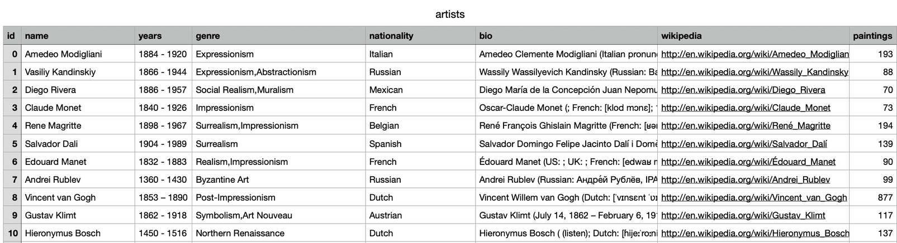

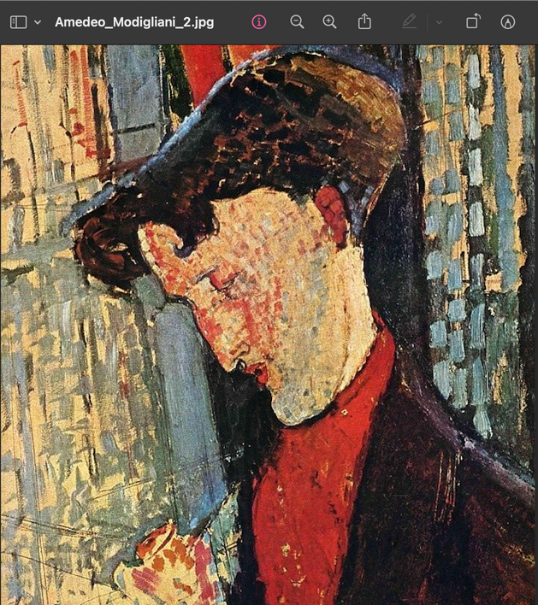
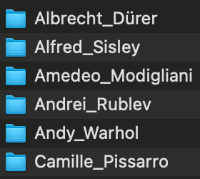
Dataset Overview
Artists.csv: 50 Artists, genre lables
resized folder: 8355 image files of paintings

Slide 5
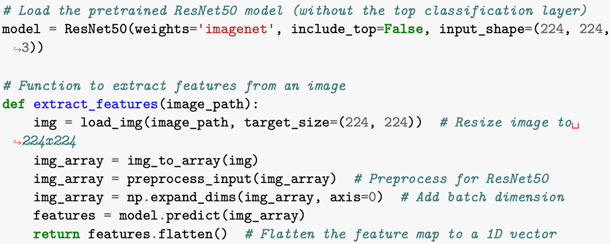

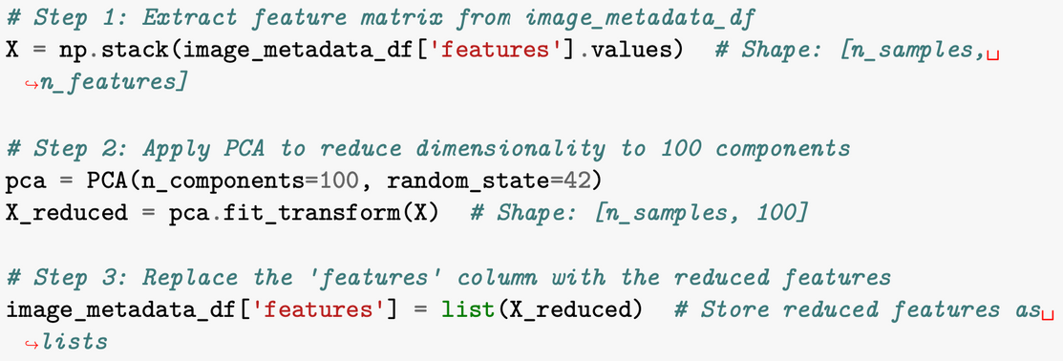
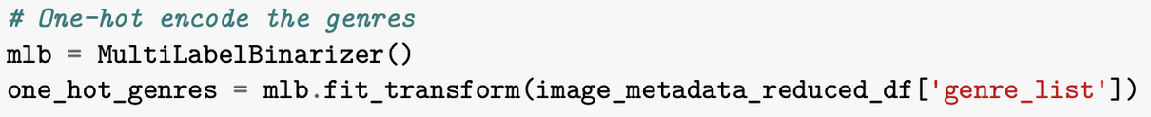
Data Preprocessing
image_metadata_reduced_df

Slide 6
Models’ Architecture

Slide 7
Model 1: Simple Neural Network (SNN)
<Structure of our SNN>
Hidden Layer 1
Size: [e.g. 512]
Hidden Layer 2
Size: [e.g. 256]
Input
Size: 100
Weight 1
Weight 2
Weight 3
Output
Size: 24
Why Only Two Layers?
Pre-trained ResNet50 & PCA
Gradient Vanishing
Insufficient data (8,355)
Computational coast
Imbalanced genre labels
Notes:
There are several possible reasons why a 2-layer SNN outperforms a deeper neural network in your project. Here are the key factors to consider:
1. Overfitting in Deeper Networks
• Reason: Deeper networks have more parameters (weights and biases) than shallow ones, making them prone to overfitting, especially when the training data size is limited.
• Impact: The deeper network may memorize the training data but fail to generalize well on the test set, leading to high training accuracy but significantly lower test accuracy.
• Why it Matters: In your project, where the genre labels are applied to paintings based on the artist (not the painting itself), there may be limited variation in genre-related features. A deeper model might capture noise or artist-specific nuances instead of general genre features.
2. Insufficient Data to Train Deeper Networks
• Reason: Deeper networks require larger datasets to effectively learn and generalize. With only 8,355 samples in your dataset, there may not be enough data to train a deep network properly.
• Impact: Without sufficient data, deeper networks fail to converge to useful features, often leading to poor generalization on the test set.
• Why it Matters: Feature representations extracted from ResNet50 are already high-dimensional. A deeper network might attempt to learn unnecessary complexity in these features, resulting in overfitting or inability to learn meaningful genre representations.
3. ResNet50 Pre-trained Features Reduce the Need for Depth
• Reason: Since the ResNet50 model already extracts powerful, high-level feature representations, only a shallow network is required to classify these features.
• Impact: Adding more layers could “relearn” pre-learned features, leading to unnecessary complexity, loss of key information, or overfitting.
• Why it Matters: ResNet50 acts as a “feature extractor” and reduces the need for more layers. Instead of raw image inputs, your SNN receives pre-processed feature vectors. Shallow networks can focus on genre classification without needing to extract visual patterns.
4. Gradient Vanishing/Exploding in Deeper Networks
• Reason: Deeper networks may suffer from vanishing or exploding gradients, making it hard for earlier layers to update their weights effectively during backpropagation.
• Impact: Poor gradient flow means that the first few layers of the deep network barely learn, while the last few layers overfit to the training data.
• Why it Matters: Although the ReLU activation helps prevent vanishing gradients, deeper networks still have difficulties due to compounding gradients through multiple layers. The 2-layer SNN avoids this issue.
5. Training Time and Computational Cost
• Reason: Training deeper networks takes significantly longer and requires more computational resources. This affects hyperparameter tuning since each experiment takes longer to complete.
• Impact: Due to resource constraints, optimal hyperparameters (like learning rate, batch size, etc.) may not be found for deeper networks.
• Why it Matters: In practice, smaller, faster models are often preferred over large, slow models if they achieve similar or better performance. Your experiments showed that smaller networks with two layers significantly reduced training time while maintaining good performance.
6. Imbalanced Genre Labels
• Reason: If certain genres are over-represented while others are under-represented, deeper networks may “overfit” to dominant genres and ignore minority genres.
• Impact: Shallow networks generalize better when the dataset is imbalanced since they are less likely to memorize over-represented genres.
• Why it Matters: Since genres in your dataset are assigned at the artist level (not for individual paintings), it is possible that certain genres are more dominant. Deeper networks might exploit this imbalance, while the simpler 2-layer SNN generalizes better.
Summary
1. Overfitting: Deeper networks memorize training data but fail to generalize.
2. Insufficient Data: 8,355 samples are too few for a deep model.
3. ResNet50 Features: Pre-trained features reduce the need for depth.
4. Vanishing/Exploding Gradients: Shallow networks avoid this issue.
5. Training Time: SNN trains faster, allowing for better hyperparameter tuning.
6. Genre Imbalance: Deeper models may overfit on dominant genres.
In summary, a 2-layer SNN is sufficient for this task because it avoids overfitting, requires less data, utilizes ResNet50 features efficiently, and avoids the computational costs of deeper models. It strikes a balance between performance, computational efficiency, and generalization, making it more effective than deeper models for this specific project.

Slide 8
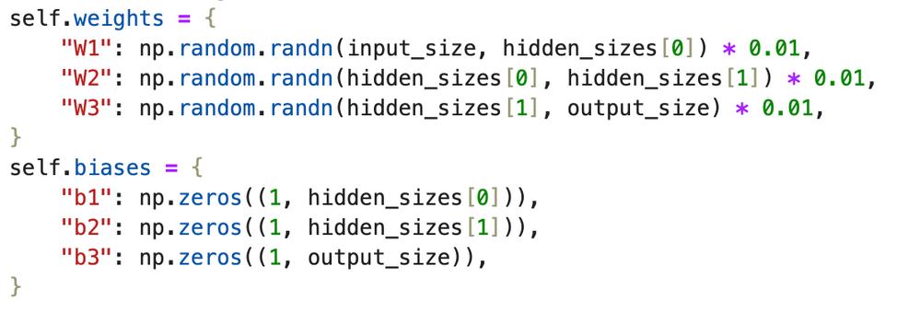
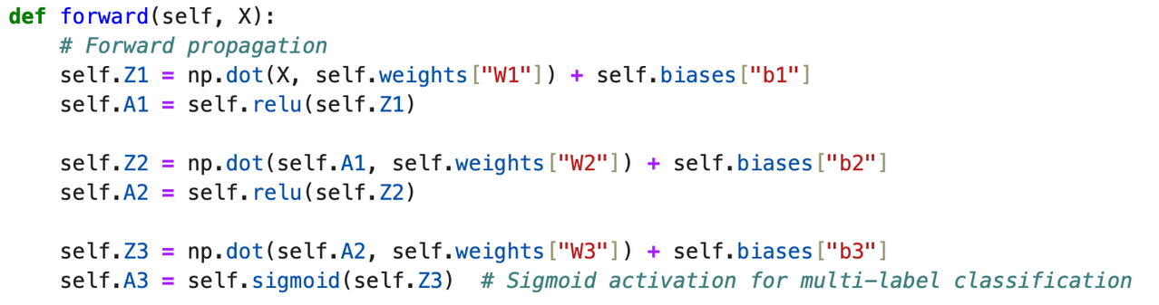
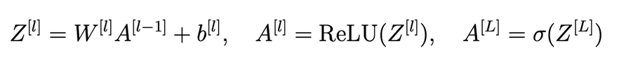
Model 1: Simple Neural Network (SNN)
1) Initalization of Parameters
2) Forward Propagation
Theory
Notes:
Theory:
1. linear transformation
2. Non-linear activation
2.1. ReLU (Rectified Linear Un
2.2 Sigmoid to obtain probabilities

Slide 9
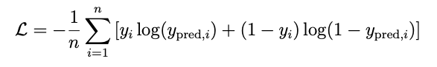
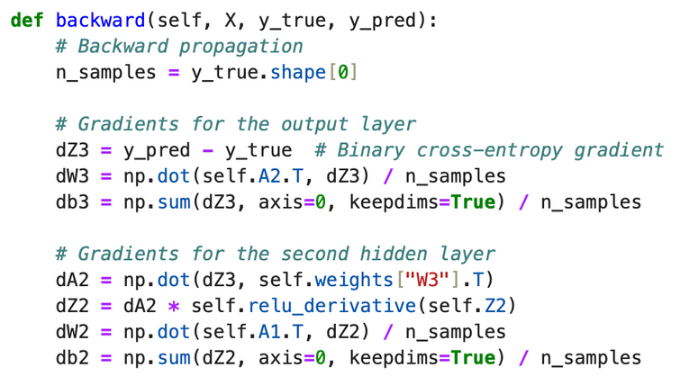
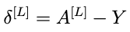
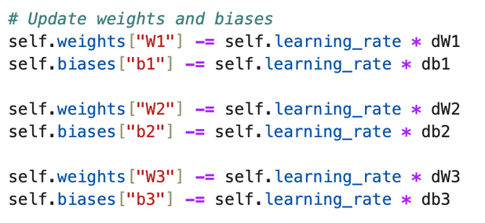
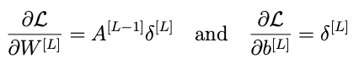
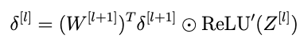
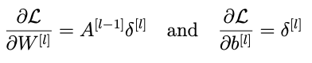
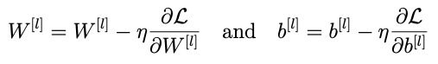
Model 1: Simple Neural Network (SNN)
3) Loss Computation
Theory
4) Backward Propagation and Weights & Bias Update
Theory
Notes:
The Binary Cross-Entropy Loss measures the difference between pre-
dicted probabilities and true labels for multi-label classificat

Slide 10
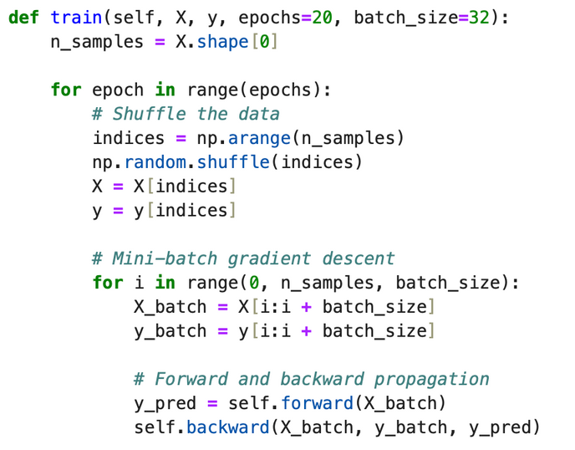
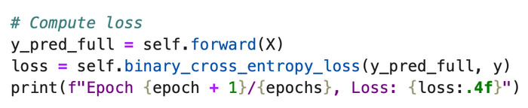
Model 1: Simple Neural Network (SNN)
6) Training Loop
Theory
Theory
Mini-batching
Epochs repeat
Notes:
The Binary Cross-Entropy Loss measures the difference between pre-
dicted probabilities and true labels for multi-label classificat

Slide 11
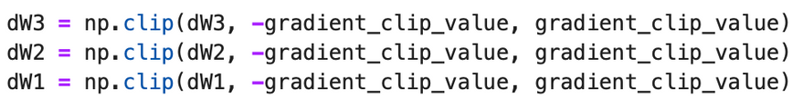
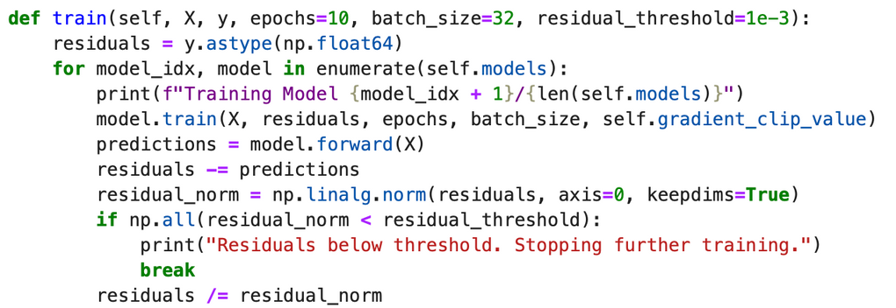
Model 2: Boosted Neural Network- Ensemble Method (BNN)
Theory
Train multiple neural networks sequentially, with each subsequent model addressing the errors of its predecessors.
1,2,3) Initalization of Parameters, Forward Propagation, Loss Computation
Same with Model 1
4) Backward Propagation and Weight & Bias Updates:
Gradient clipping ensures that gradients do not exceed a predefined threshold, avoiding unstable updates. For this model, the clipping value is set to 0.5
5) (Ensemble) Training Residual Updates:
Gradient clipping ensures that gradients do not exceed a predefined threshold, avoiding unstable updates. For this model, the clipping value is set to 0.5
Notes:
The Binary Cross-Entropy Loss measures the difference between pre-
dicted probabilities and true labels for multi-label classificat

Slide 12
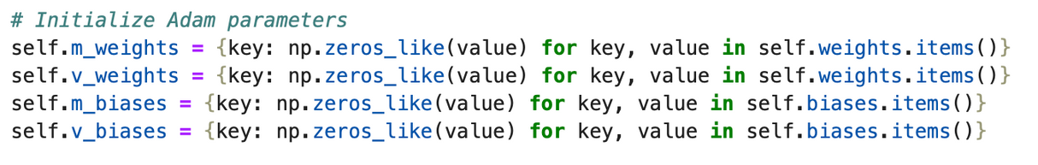
Model 3: Adam Optimizer Method
Theory
Adam optimizer leverages an adaptive learning rate optimization algorithm.
1) Initalization of Parameters:
Additional parameters for moment estimates.
2, 3) Forward Propagation, Loss Computation
Same with Model 1
Notes:
The Binary Cross-Entropy Loss measures the difference between pre-
dicted probabilities and true labels for multi-label classificat

Slide 13
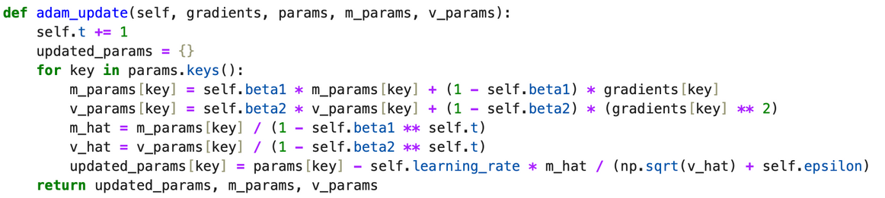
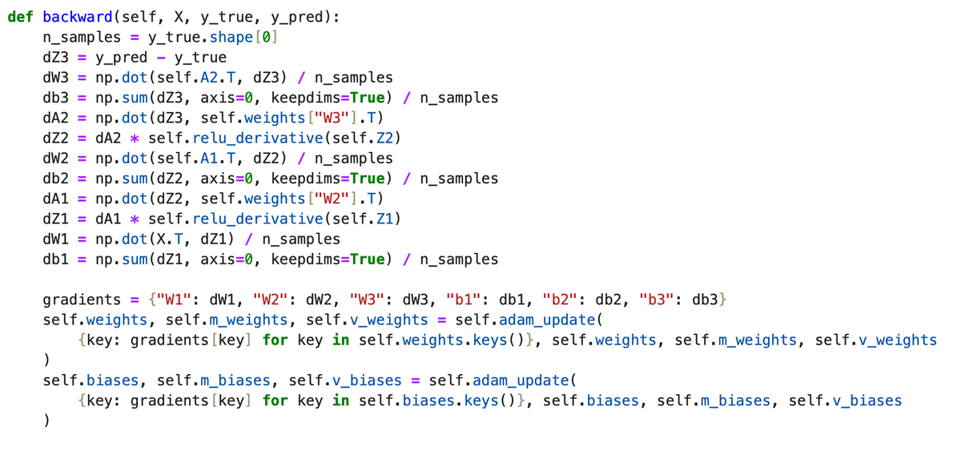
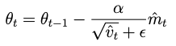
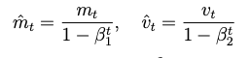
Model 3: Adam Optimizer Method
4) Backward Propagation
Adopt Adam Optimization algorithm
Theory
Notes:
beta 1,2: Exponential decay rates for the moment estimates
g_t: gradient at time t
...

Slide 14
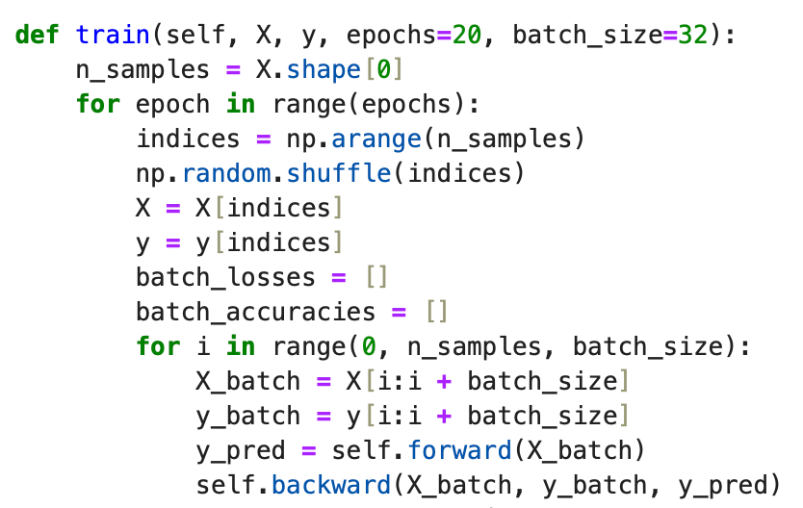
Model 3: Adam Optimizer Method
5) Training
Incorporates the unique Adam update mechanism during the parameter update.
Notes:
beta 1,2: Exponential decay rates for the moment estimates
g_t: gradient at time t
...

Slide 15
Evaluation & Results

Slide 16
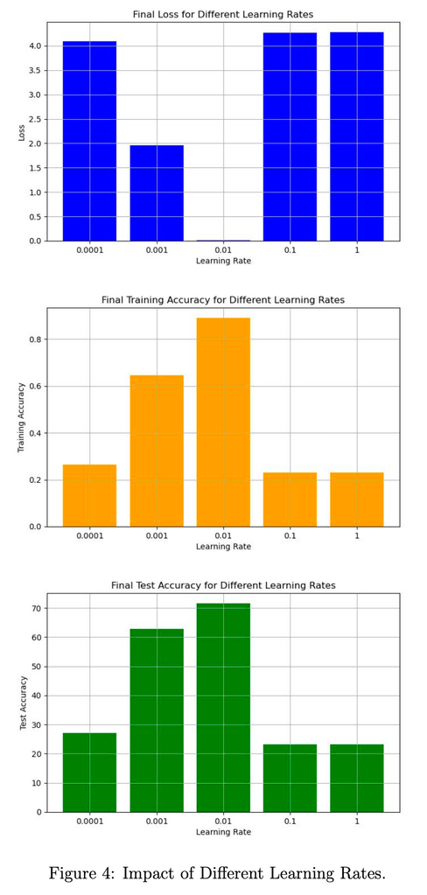
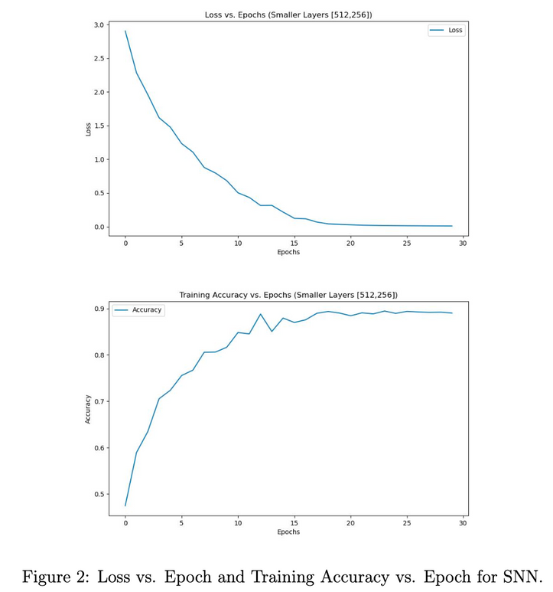
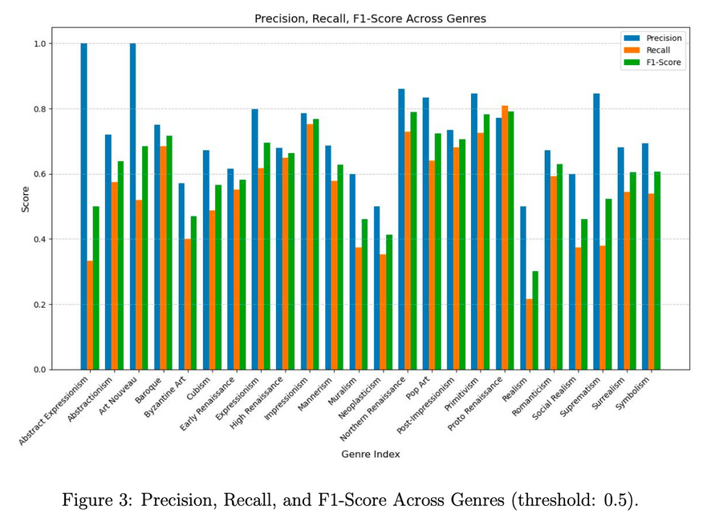
Key results: Simple Neural Network
The model evaluates multi-label classification by checking if predicted genres match any associated with the artist. For the architecture [512, 256] and a learning rate of 0.01, the SNN achieved a test accuracy of 73.13%.

Slide 17
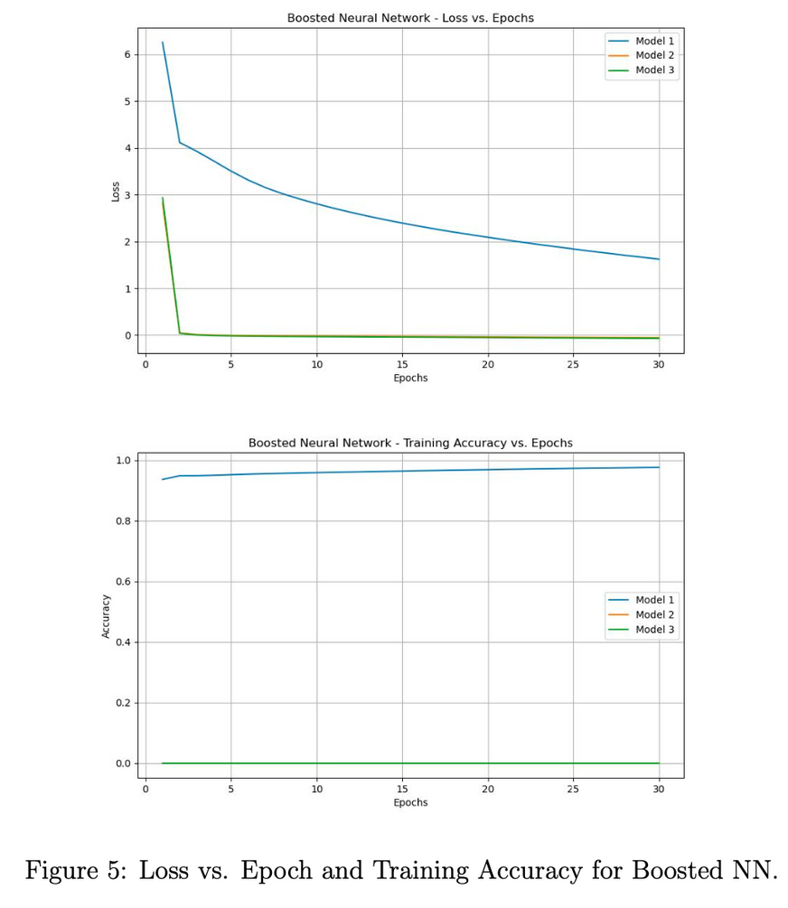
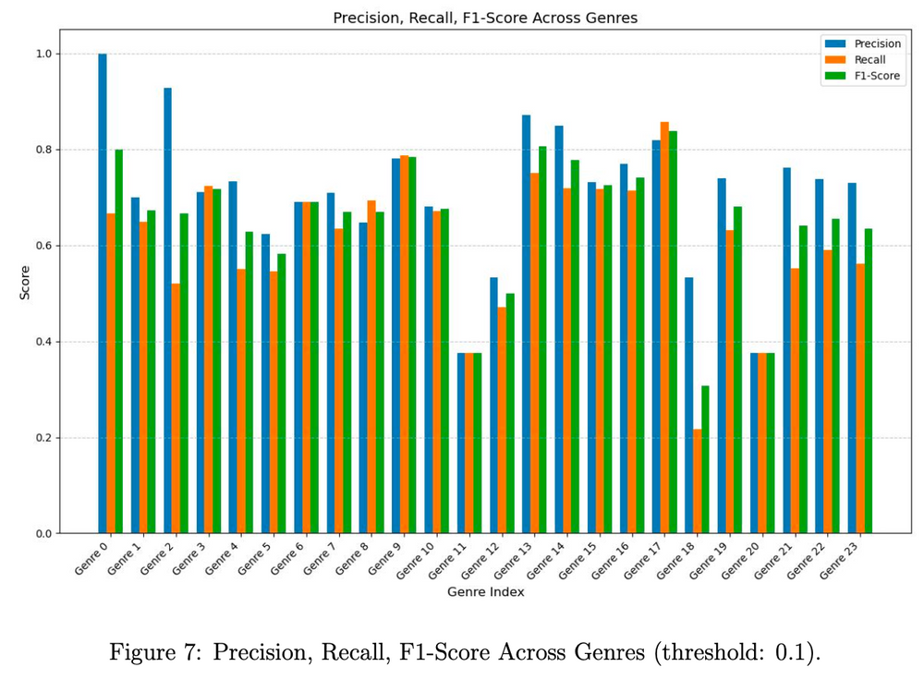
Key results: Boosted Neural Network
BNN achieved a test accuracy of 73.25% using the same evaluation method as SNN.

Slide 18
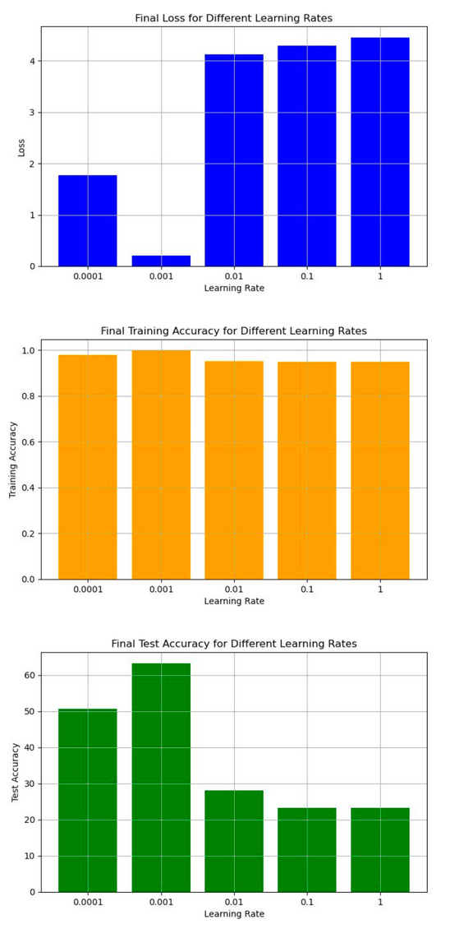
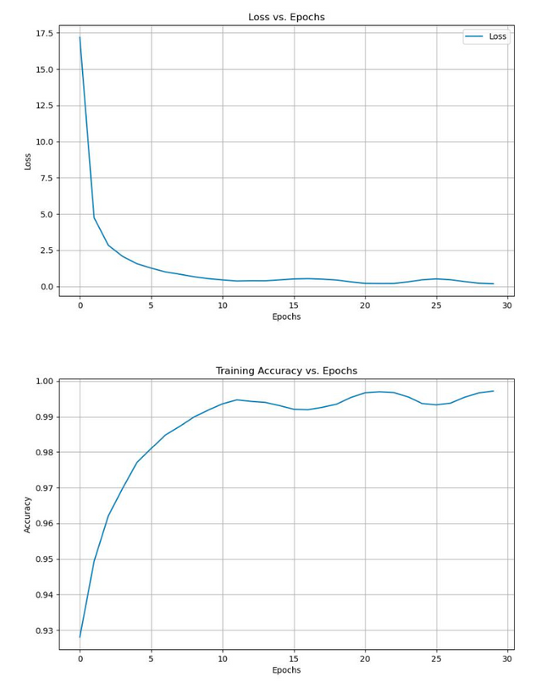
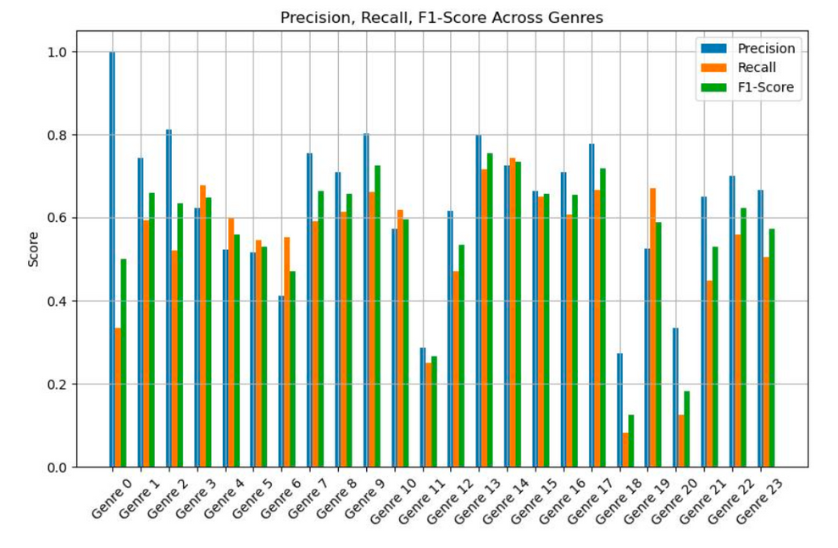
Key results: Adam Optimizer Method
Adam Optimizer Method achieved a test accuracy of 66.55% using the same evaluation method as SNN. The Adam model exhibits higher variance in precision and recall, indicating less consistent performance across genres. This reflects the Adam model’s tendency to converge faster but with reduced accuracy compared to the SNN.

Slide 19
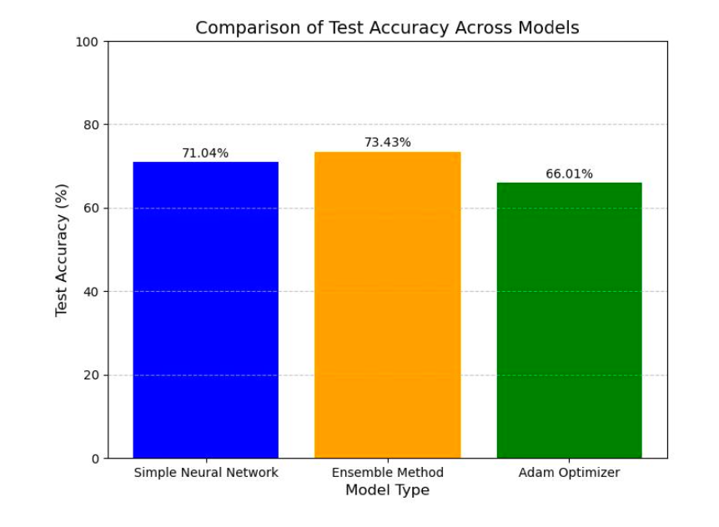
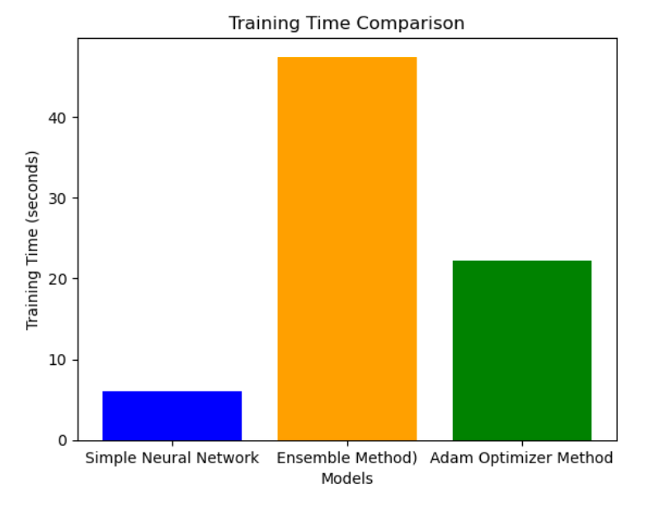
Comparison between all 3 models

Slide 20
Limitations & Potential Improvements

Slide 21
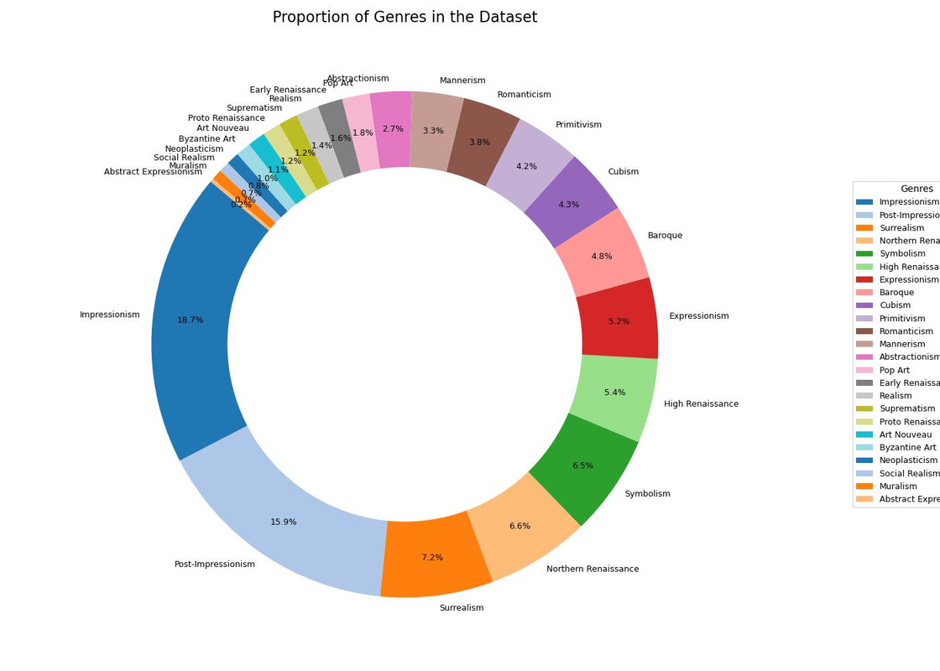
Limitations and improvements
Imbalanced Dataset:
Genre Imbalance Issue:
Genres like Impressionism dominate the dataset, while others (e.g., Abstract Expressionism) are underrepresented.
Impact on Performance:
Imbalance leads to lower Precision, Recall, and F1-Scores for minority genres.
Solutions to Improve Performance:
Data Augmentation: Increase samples for minority genres by generating synthetic data.
Balanced Sampling: Ensure models train on a more balanced subset of data to improve generalization across all genres.

Slide 22
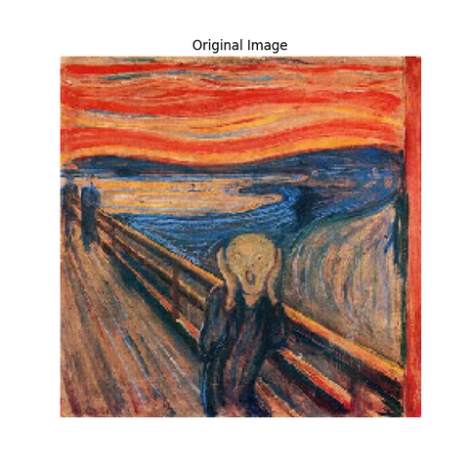
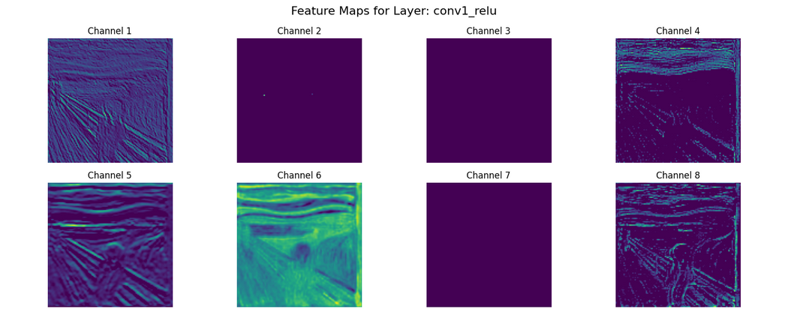
Limitations and improvements
Imperfect Feature Extraction with ResNet50:
Pretrained ResNet50 Limitations:
ResNet50, trained on ImageNet, excels at general object recognition.
It may struggle to capture the nuanced stylistic details needed for art genre classification.
Feature Mismatch:
Extracted features may not fully align with the specific requirements of art classification tasks.
Performance Improvement Strategies:
Fine-Tuning: Retrain ResNet50 on domain-specific art datasets to better capture stylistic features.
Attention Mechanisms: Integrate attention techniques to help the model focus on important stylistic details.

Slide 23
Conclusion

Slide 24
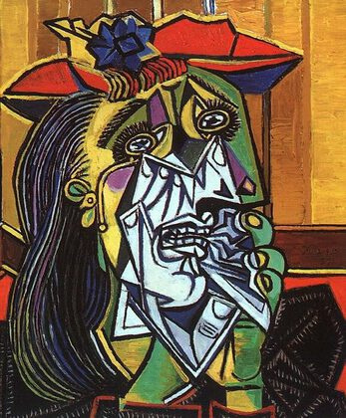
Conclusion
Research Implications:
Demonstrates the potential of machine learning for art genre classification.
Shows that Boosted Neural Networks (BNN) provide the best accuracy (73.43%) through ensemble learning, while Simple Neural Networks (SNN) offer efficiency and practicality.
Future Directions:
Address Dataset Imbalance: Use balanced sampling or data augmentation to improve performance for underrepresented genres.
Domain-Specific Fine-Tuning: Adapt ResNet50 to art datasets for better feature extraction.
Broader Impact:
Machine learning can support art education, digital curation, and the preservation of cultural heritage by enabling efficient and accurate art classification.

